Slide 1
Fostering Multimodal Digital Literacy for Youth Empowerment in Digital Entrepreneurs and Sustainable Tourism Sectors
No. Abstract: ICOLLITE- 25114
Rosita Rahma, Yana Setiawan, Fahmi Jahidah Islamy, Restu Surya Dinagara, Ihsan Sopian Sutarjat
Universitas Pendidikan Indonesia

Slide 2
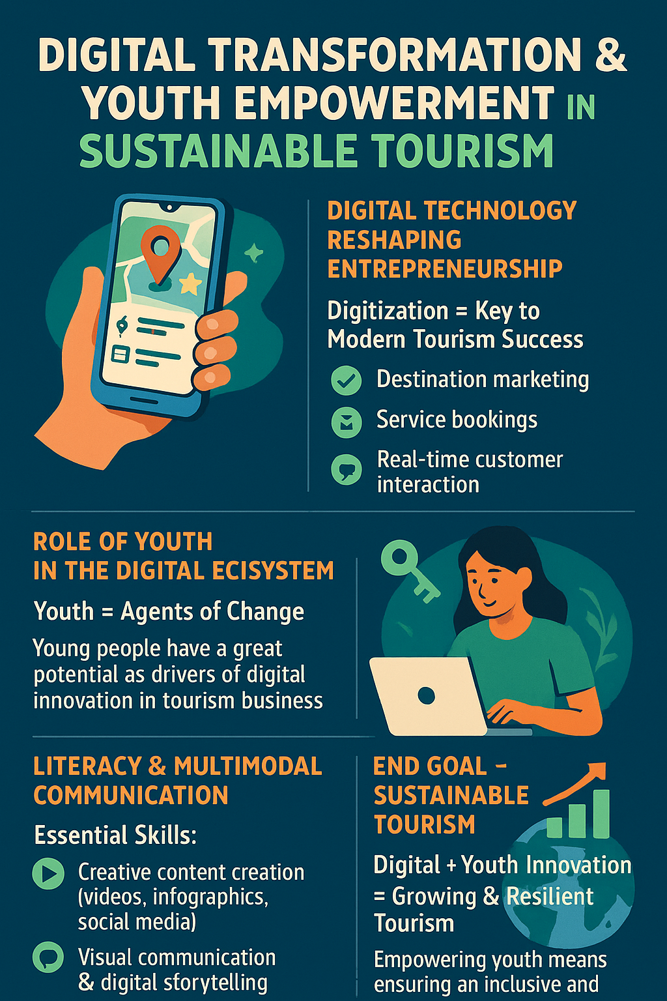
INTRODUCTION
Youth empowerment
Digital Entrepreneurship Readiness
Multimodal Literacy

Slide 3
LITERATURE REVIEW
Digital entrepreneurship in tourism enables innovation and sustainability through online tools (Kraus et al., 2018; Sigala, 2018). Youth empowerment supports entrepreneurial activity, especially when paired with multimodal literacy—the ability to communicate across digital and visual modes (Kress, 2010). Research shows this literacy mediates the link between empowerment and digital readiness (García & Wei, 2014). However, gaps remain in integrating these elements within sustainable tourism frameworks.
This study aims to offer new insights for the development of more effective training programs and policy frameworks that enhance the digital entrepreneurship ecosystem, grounded in multimodal literacy and youth empowerment within the sustainable tourism sector.

Slide 4
METHOD
COMPONENT | DESCRIPTION
Type | Correlational Quantitative
Respondents | 35 Individuals from a Selected Population
Instrument | Closed-Ended Questionnaire using a Likert Scale
Analysis | Pearson Correlation and Multiple Linear Regression

Slide 5
FINDING AND DISCUSSION
VARIABLE 1 | VARIABLE 2 | CORRELATION COEFFICIENT (R)
Multimodal Literacy | Youth Empowerment | 0.640
Multimodal Literacy | Digital Entrepreneurship & Sustainable Tourism Readiness | 0.658
Youth Empowerment | Digital Entrepreneurship & Sustainable Tourism Readiness | 0.681

Slide 6



FINDING
Multimodal literacy shows a significant correlation with youth empowerment (r = 0.640), as well as with digital entrepreneurship readiness (r = 0.658)
Youth empowerment is strongly correlated with entrepreneurial readiness (r = 0.681)
The regression analysis indicates an R² value of 0.547, with youth empowerment emerging as the stronger predictor

Slide 7
DISCUSSION
The results support empowerment theory (Zimmerman, 2000) and digital literacy frameworks (Belshaw, 2012; Rowsell & Walsh, 2021). The findings of this study are consistent with Hobbs (2021), who underscores the significance of critical digital literacy as a prerequisite for meaningful economic participation. Youth empowerment enhances both self-efficacy and resilience, which are fundamental attributes for entrepreneurial success.
The practical implications suggest the necessity of developing a comprehensive curriculum that integrates multimodal literacy with entrepreneurial education and training.

Slide 8
CONCLUSION
1
Multimodal literacy encompasses not only technical skills but also interpretive, collaborative, and adaptive abilities within complex digital environments.
2
Educational policy should prioritize the development of curricula that integrate multimodal digital literacy from an early stage.
3
Youth training programs should incorporate elements of leadership, entrepreneurial initiative, and an understanding of the dynamics of digital-based sustainable tourism.
4
Both government and private sectors are encouraged to establish entrepreneurial incubators that foster and support these dual competencies.

Slide 9
REFERENCES
Belshaw, D. A. J. (2012). The Essential Elements of Digital Literacies. Self-published.
García, A., & Wei, M. (2014). Multimodal literacy and digital competence in youth entrepreneurship. Journal of Youth Studies, 17(3), 415-429.
Hobbs, R. (2021). Media Literacy in Action: Questioning the Media. Rowman & Littlefield.
Kraus, S., et al. (2018). Digital entrepreneurship: Toward a framework for research. Journal of Business Venturing, 33(5), 545-564.
Kress, G. (2010). Multimodality: A social semiotic approach to contemporary communication. Routledge.
Rowsell, J., & Walsh, M. (2021). Rethinking Literacy Education in New Times: Multimodality, Multiliteracies, and Digital Literacies. Language and Education, 35(4), 305–317.
Sigala, M. (2018). Social media and customer engagement in the tourism industry. Tourism Management, 66, 341-350.
Zimmerman, M. A. (2000). Empowerment theory: Psychological, organizational and community levels of analysis. In Handbook of Community Psychology.

Slide 10
THANK YOU!

